Slide 1
Evaluation of Weather Forecast with Deep Learning
Muhammad Moaz Amin – Winter Semester 2021
Deep Learning

Slide 2
“Researchers have found that merely asking people to assume their initial judgment is wrong, to seriously consider why that might be, and then make another judgment, produces a second estimate which, when combined with the first, improves accuracy almost as much as getting a second estimate from another person.”
Philip E. Tetlock, Superforecasting: The Art and Science of Prediction

Slide 3
Agenda
Personal Motivation
Introduction
Machine Learning
Recurrent Neural Network
Convolution Neural Network
Challenges of Weather Forecasting
Research Methodology
Implementation
Conclusion
References

Slide 4

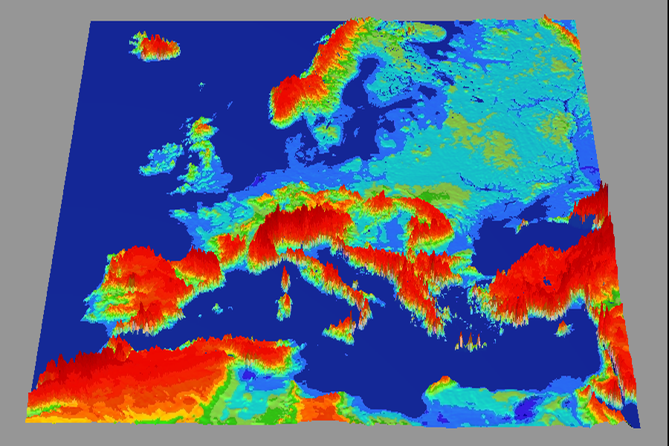

Personal Motivation
Today Meteorologists rely on numerical models to predict wind speed, precipitation, air pressure and other factors that indicate the path and intensity of a weather event. E.g. a hurricane, storm, blizzard
How can this process be optimised so that all weather conditions can be predicted as accurately as possible and with least amount of human intervention?

Slide 5

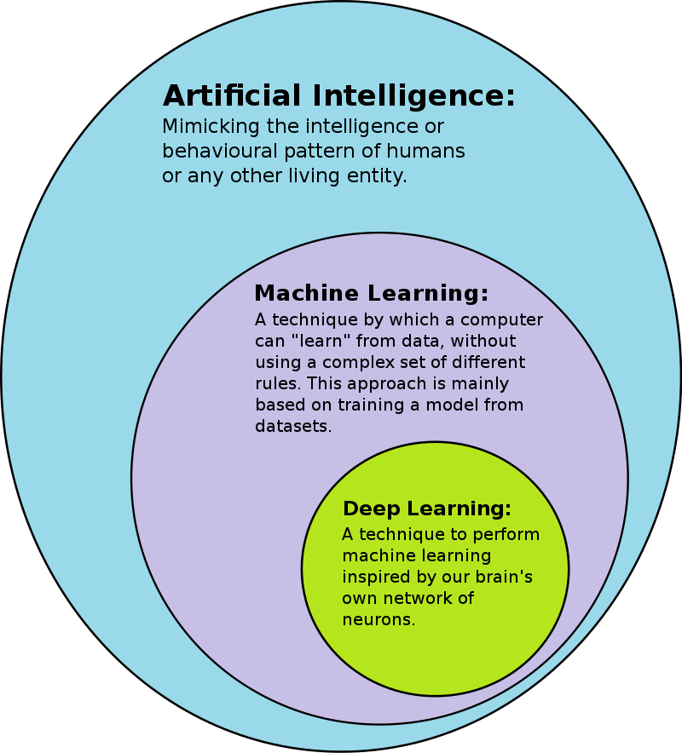
Introduction
Due to its impact on worldwide human life, weather forecasting has attracted the interest of numerous scholars from diverse research areas.
What is Deep Learning?
Deep Learning is a subfield of machine learning concerned with algorithms inspired by the structure and function of the brain called artificial neural networks.

Slide 6

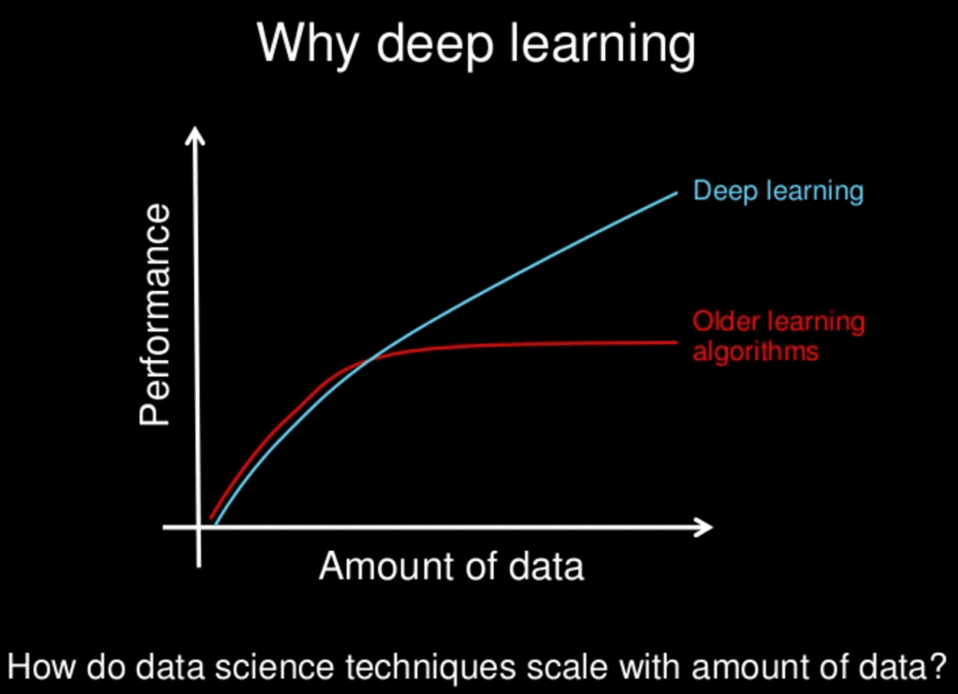
Properties of Deep Learning
Results get better with
More data
Bigger models
More computation
This results in better algorithms, new insights and improved techniques which ultimately help as well

Slide 7
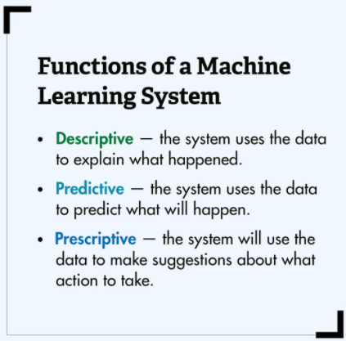
Machine Learning
Machine learning is a subfield of artificial intelligence, which is broadly defined as the capability of a machine to imitate intelligent human behaviour.
It is main goal is to create mathematical models from samples using statistics.
Machine learning can be split into different categories
Prediction
Feature selection
Dimensional reduction

Slide 8
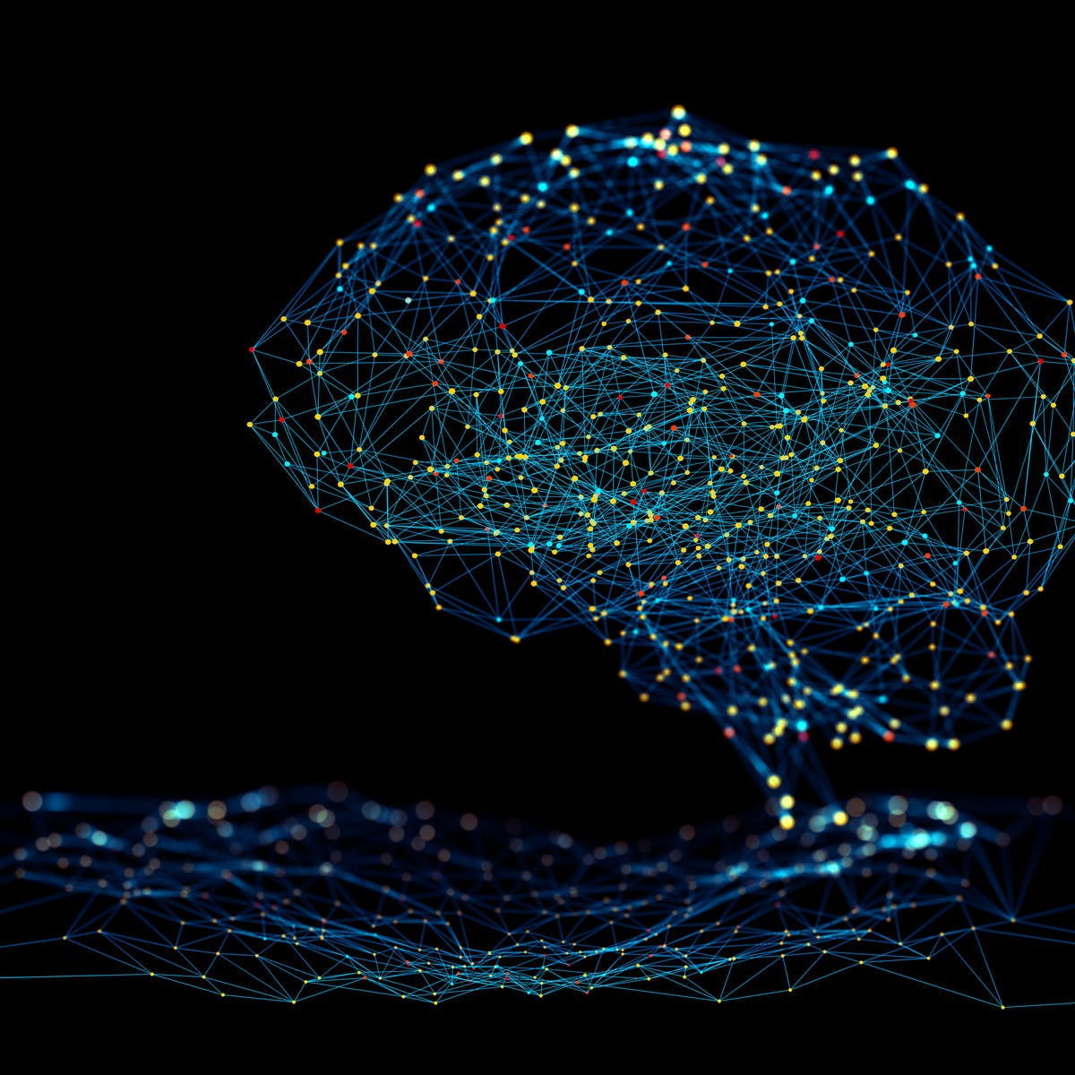
Neural Network
A neural network is a computer System which has been modelled on the human brain and nervous system.
Types of Neural Networks
Feed-Forward Neural Network
Recurrent Neural Network (RNN)
Convolution Neural Network (CNN)

Slide 9
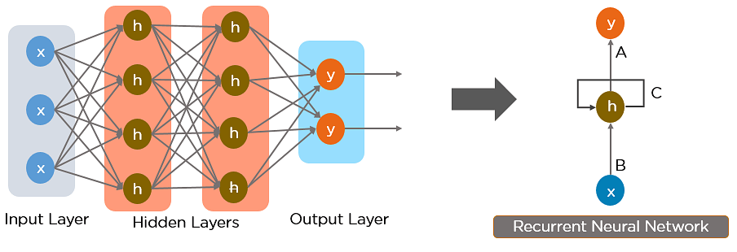
Recurrent Neural Network
Recurrent Neural Network (RNN) is a special type of NN which is known as being an artificial type and is commonly used for time series predictions.
It works on the principle of saving the output of a particular layer and feeding this back to the input in order to predict the output of the layer.

Slide 10
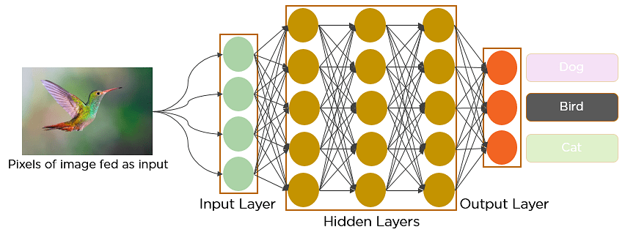
Convolutional Neural Network
A convolutional neural network is a feed-forward neural network that is generally used to analyse visual images by processing data with grid-like topology.
Properties
Good at picking up on patterns in the input image
Contains many layers stacked on top of each other

Slide 11

Challenges of Weather Forecasting with Deep Learning
Weather forecasting is essentially a prediction of spatiotemporal features based on a diverse array of observations from ground-based, airborne and satellite platforms.
Different processes determine the evolution
There are missing and erroneous values in observation data
Coupling is across wide range of spatiotemporal scales
There is auto correlation of time series
There are dynamic correlations
Periodicity
Imbalanced data: scarcity of extreme events
Strong need to quantify uncertainties

Slide 12
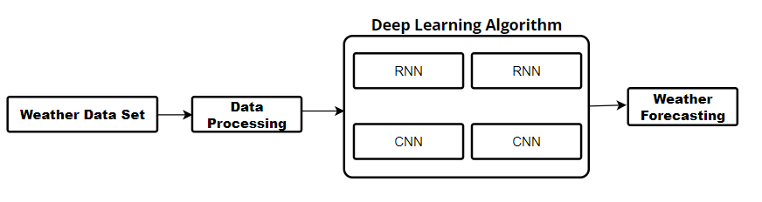
Research Methodology
Finding the right dataset
Kaggle, FiveThirtyEight, Socarta and Github Repositories
Getting it ready to be used
Filtering out unnecessary information
Processing the data
Implementing DL Algorithm
Forecasting Weather

Slide 13
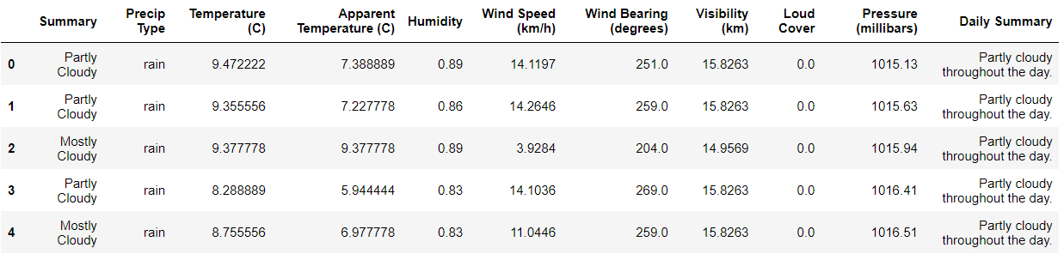
Implementation
Reducing and normalising the data set

Slide 14
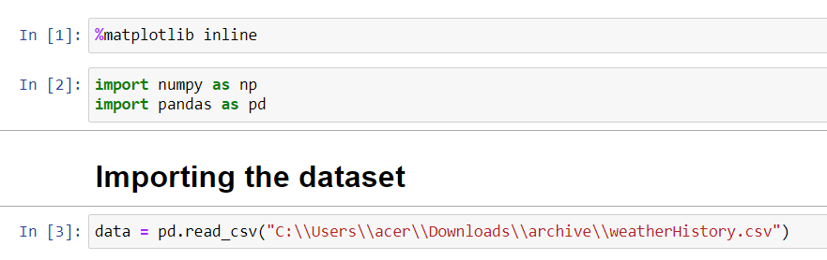
Implementation in Python Code

Slide 15
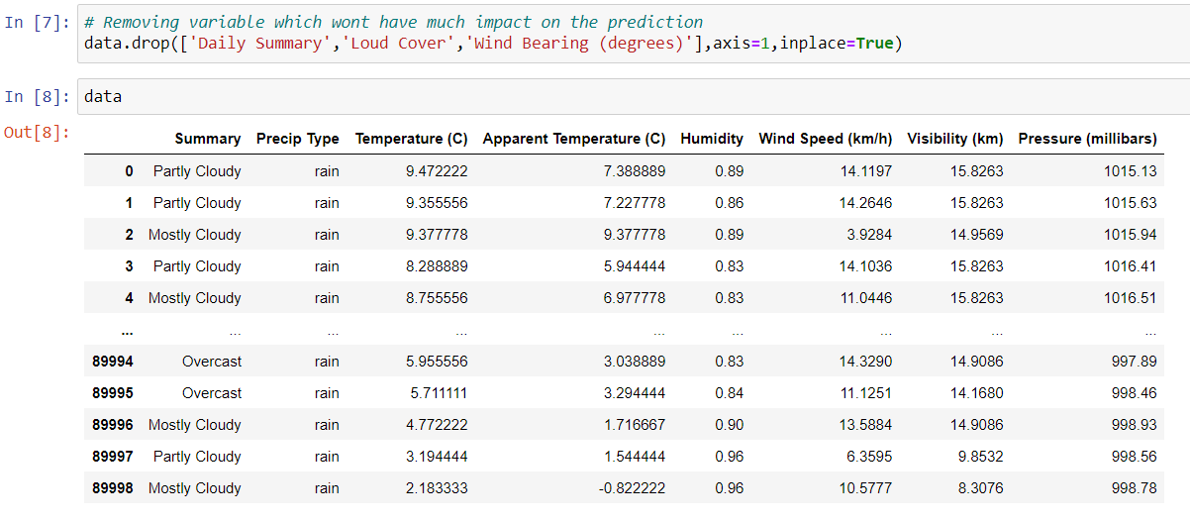
Dropping the less important variables

Slide 16
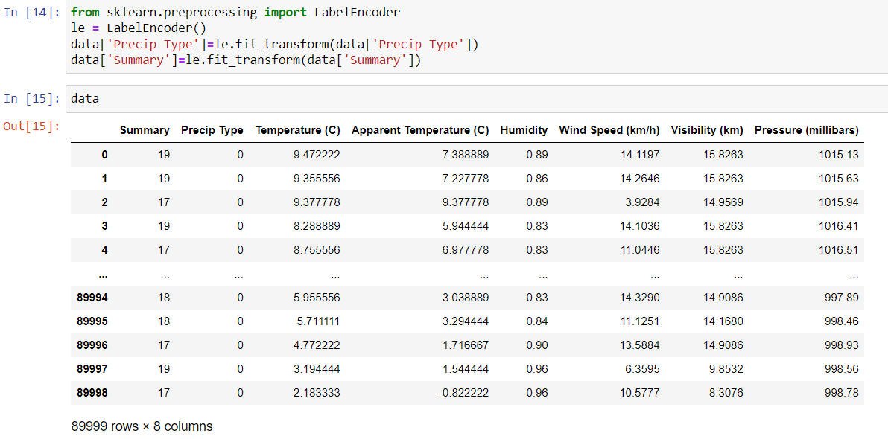
Converting categorical data into numerical data

Slide 17
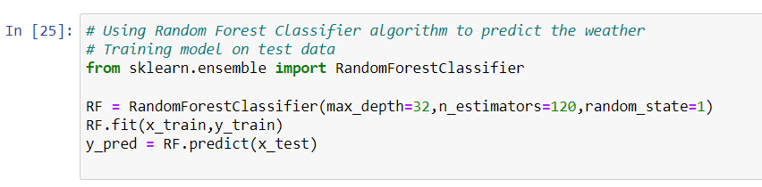
Training the data

Slide 18

Measuring the Accuracy and Result

Slide 19
Conclusion
Very Early stage for market ready
Weather data is unique and require new methodologies to be developed
At the moment it can be applied effectively to understand meteorological phenomenon
It has number of associated challenges
Currently it is very open to collaboration

Slide 20
References
Lynch P. 2008The origins of computer weather prediction and climate modeling. J. Comput. Phys. 227, 3431–3444.
Linnainmaa S. 1970The representation of the cumulative rounding error of an algorithm as a taylor expansion of the local rounding errors. Master’s Thesis (in Finnish), Univ. Helsinki.
Bengio, Y., Lamblin, P., Popovici, D., and Larochelle, H. ”Greedy layerwise training of deep networks.,” Advances in neural information processing systems, vol. 19 (153) 2007.
Kaggle.com. 2022. Weather prediction. [online] Available at: ¡https://www.kaggle.com/dheerajbalchandani/weather-prediction/data¿ [Accessed 12 January 2022].
DeepAI. 2022. Convolutional Neural Network. [online] Available at: <https://deepai.org/machine-learning-glossary-and-terms/convolutional-neural-network.
2022. [online] Available at: <https://www.simplilearn.com/tutorials/deep-learning-tutorial/convolutional-neural-network.

Slide 21

Questions?

Slide 22

Thank You

